Slide 1







IEEE SSH 2024
HACKATHON
KATHON

Slide 2



Team name: Smart Stop
Team Members name:
Shaunak Hawaldar
Devesh Dabhade
Manasi Choudhari

Slide 3


Problem statement
Open Innovation for citizen - led Smart City Software Solutions
How might we create a platform that enables citizens, urban planners, and developers to co-create and implement open-source software solutions for smart cities, focusing on areas like traffic management, energy efficiency, and public safety?

Slide 4

Solution
This project aims to decongest the heavy traffic on the Indian roads, caused due to the current fixed time signal systems. It also aims to dynamically change the duration of signals, based on the volume of traffic at different times of the day, using Deep Learning algorithm, Convolutional Neural Network (CNN), to increase the efficiency of traffic management and by providing real-time traffic condition forecasts for scheduling the traffic signal controls.

Slide 5
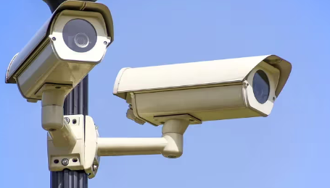

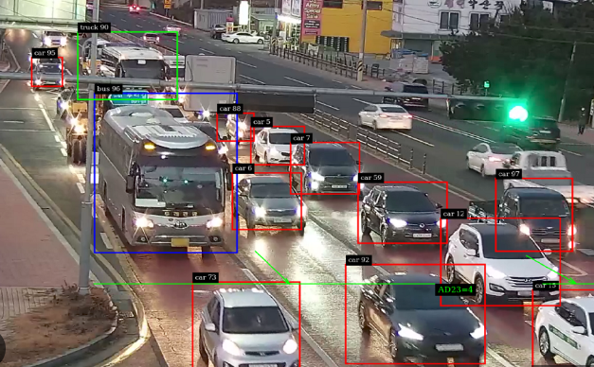
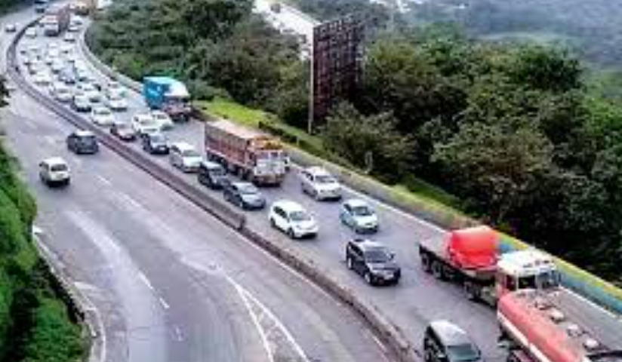
Vehicles from Lane 1 as Input from Cameras/Sensors (Pandas)
Real-time data ingestion, API integration, Data scraping, Data streaming, Traffic loop detectors, cameras, weather stations.
Data pre-processing
Pandas, NumPy, OpenCV, TensorFlow, PyTorch
Analyse the image through pixels using CNN
Image processing by ReLU (Detect volume of traffic)
Using Pooling Layer for Classification
Check for traffic density and set the time duration for RYG lights
Matplotlib, Seaborn, Plotly can help visualize traffic data predictions, and recommendations to aid decision-making.

Slide 6


USP
Saves Time and Money (Fuel + maintenance cost)
Reduction in number of accidents
Enables control of high traffic flow points [4]
Increases precision of measuring traffic density [4]
Increases Fuel Efficiency (Reduce fuel consumption)
Protect the environment from the hazardous impacts of pollution (reduced carbon footprint)
It would prove effective for emergency services (like ambulance & fire brigades) , logistics and for all the road services that require urgency and swiftness

Slide 7


Tech Stack
DATA PROCESSING & MONITORING
Apache Spark
Apache Kafka
(Real time data ingestion)
Grafana
Prometheus
(system health and performance monitoring)
AI & ML
TensorFlow, PyTorch for deep learning models.
Scikit-learn: For traditional machine learning models.
OpenCV
(video processing)
GeoPandas
( mapping traffic patterns)
IOT & SENSORS
Raspberry Pi or Arduino
Ultrasonic Sensors (for distance measurement), Camera Systems (object recognition) Environmental Sensors (to check AQI, weather conditions & change the wait time accordingly)

Slide 8


Future Prospects
Dynamic Lane Management: Smart Traffic Signals can prioritize lanes for public transport or emergency vehicles based on real-time conditions, improving overall traffic flow.
Pedestrian and Cyclist Safety: It can detect pedestrians and cyclists, adjusting traffic lights and signals to prevent accidents.
Eco-Friendly Routing: Smart Traffic Signals can suggest alternate routes to drivers, reducing fuel consumption and overall emissions.
Smart City Integration: Integrating with other urban infrastructure like public transport, utilities, and emergency services for a more cohesive and efficient urban environment.

Slide 9
References
[1] Bajaj, Mr.Ratan. (2023). A research paper on AI for traffic management. 10.13140/RG.2.2.21119.69287.
[2] K M, Sujith & S, Nikhil. (2019). Introducing Artificial Intelligence in Traffic Management for a Sustainable Urban Development.
[3] Shridevi Jeevan Kamble, Manjunath R Kounte, Machine Learning Approach on Traffic Congestion Monitoring System in Internet of Vehicles, Procedia Computer Science, Volume 171,2020,Pages 2235-2241, ISSN 1877-0509, https://doi.org/10.1016/j.procs.2020.04.241.
[4] Y. Qin, H. Luo, F. Zhao, C. Wang, J. Wang and Y. Zhang, "Toward Transportation Mode Recognition Using Deep Convolutional and Long Short-Term Memory Recurrent Neural Networks," in IEEE Access, vol. 7, pp. 142353-142367, 2019, doi: 10.1109/ACCESS.2019.2944686.
Thank You

